Slide 1
Simulink
2023. 12. 06
SMEET LAB

Slide 2
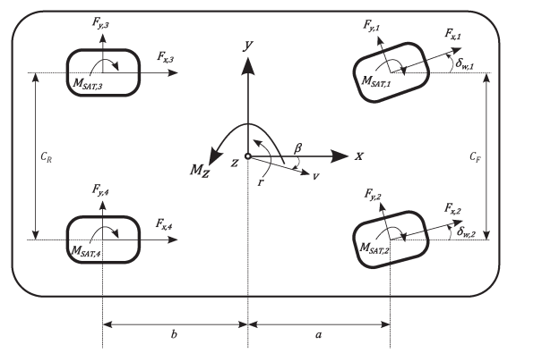

Sensitivity analysis
Vehicle yaw momentum equation
$J_{z}\dot{r}=\left(−F_{y,2}sinδ_{w,2}+F_{y,1}sinδ_{w,1}+F_{x,2}cosδ_{w,2}−F_{x,1}cosδ_{w,1}\right)\frac{C_{F}}{2}+\left(−F_{y,2}cosδ_{w,2}+F_{y,1}cosδ_{w,1}+F_{x,2}sinδ_{w,2}+F_{x,1}sinδ_{w,1}\right)a−\left(F_{y,4}+F_{y,3}\right)b+\left(F_{x,4}−F_{x,3}\right)\frac{C_{R}}{2}−M_{SAT,1}−M_{SAT,2}$- $M_{SAT,2}$- $M_{SAT,4}$
Control Value : $M_{φc }=\left(F_{x,2}cosδ_{w,2}−F_{x,1}cosδ_{w,1}\right)\frac{C_{F}}{2}+\left(F_{x,2}sinδ_{w,2}+F_{x,1}sinδ_{w,1}\right)a+\left(F_{x,4}−F_{x,3}\right)\frac{C_{R}}{2}$
Unknown value : $M_{φY}=\left(−F_{y,2}sinδ_{w,2}+F_{y,1}sinδ_{w,1}\right)\frac{C_{F}}{2}+\left(+F_{y,2}cosδ_{w,2}+F_{y,1}cosδ_{w,1}\right)a−\left(F_{y,4}+F_{y,3}\right)b, M_{SAT}$

Slide 3
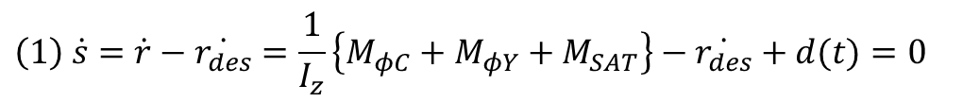

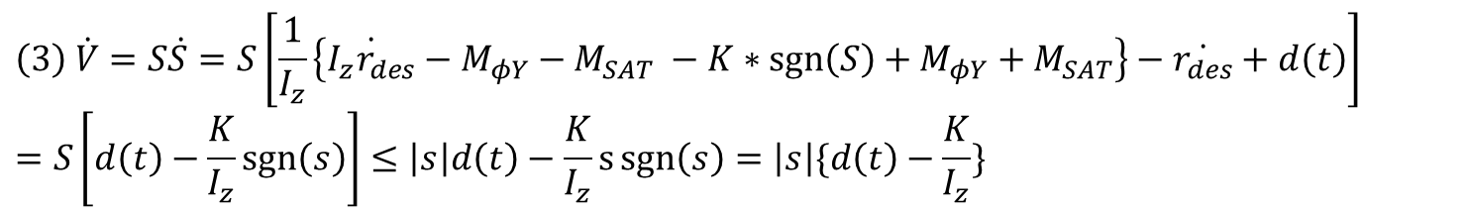
Sensitivity analysis
Sliding Mode Control
Sliding Surface : $S=r−r_{des}$
For SMC we need to input control that satisfying $S=0, \dot{S}=0$
the requirement of an asymptotic stability through the Lyapunov function $V\left(s\right)=\frac{1}{2}S^{2}, \dot{V}=S\dot{S}≤0$
$$\left(1\right) \dot{s}=\dot{r}−\dot{r_{des}}=\frac{1}{I_{z}}\left\{M_{φC}+M_{φY}+M_{SAT}\right\}−\dot{r_{des}}+d(t)=0$$
$$\left(2\right) M_{φC}=\dot{I_{z}∗r_{des}}−M_{φY}−M_{SAT} −K∗sgn⁡(S)$$
$$\left(3\right) \dot{V}=S\dot{S}=S\left[\frac{1}{I_{z}}\left\{\dot{I_{z}r_{des}}−M_{φY}−M_{SAT} −K∗\operatorname{sgn}\left(S\right)+M_{φY}+M_{SAT}\right\}−\dot{r_{des}}+d\left(t\right)\right]=S\left[d\left(t\right)−\frac{K}{I_{z}}\operatorname{sgn}\left(s\right)\right]≤\left|s\right|d\left(t\right)−\frac{K}{I_{z}}s\operatorname{sgn}\left(s\right)=\left|s\right|\{d\left(t\right)−\frac{K}{I_{z}}\}$$

Slide 4

Sensitivity analysis
Sliding Mode Control
So $if d\left(t\right)<\frac{K}{I_{Z}}$, sliding surface always converges

Slide 5
THANK YOU!

